Slide 1
2018 11.12 TP CAB User Experience Workshop Proposal
Pacha Chen｜UX Researcher, HIE

Slide 2
Agenda
Time | Activity | Time | Owner
12:00pm-12:05pm | Opening | 5 | Russ?
12:05pm-12:25pm | Update from last year CAB UX workshop | 20 | Russ / Michael
12:25pm-12:30pm | Workshop overview | 5 | Pacha
12:30pm-01:00pm | Warm up game | 30 | Pacha
01:00pm-02:30pm | Research | 90 | Pacha
02:30pm-02:40pm | Break | 10
02:40pm-03:25pm | Product planning | 45 | Pacha
03:25pm-04:15pm | Product design | 50 | Pacha
04:15pm-04:45pm | Sell | 30 | Pacha
04:45pm-04:50pm | Vote | 5 | Pacha
04:50pm-05:00pm | Closing | 10 | Russ?

Slide 3
Scene: A big company is looking for an innovation of SMS for Security Operation Center. CEO wants to create a positive competition environment and encourage entrepreneurship in the company, so he decides to provide bonus for the group coming out the most innovative and valuable concept. You are the external consultant recruited by CEO to help the team gain customer insights for innovation.
Each team consists of:
4-5 Customers
2-3 Trenders
At least one engineer

Slide 4
Product Planning
Research
Design
Sell

Slide 5

Product Planning
Research
Design
Sell

Slide 6
Are you familiar with the market?
Warm-up
Rules:
Roll the dice and decide which team guesses the answer first.
1 point for the team guess the correct answers
One answer 1 point.
Rules:
Roll the dice and decide which team guesses the answer first.
1 point for the team guess the correct answers
One answer 1 point.

Slide 7

Are you familiar with the market?
Warm-up - A
What do TP users COMPLAINT about the most?
Don’t make it easy for customers to figure out if the IPS blocked traffic.
What do TP users LIKE the most?
Rules:
Roll the dice and decide which team guesses the answer first.
1 point for the team guess the correct answers
One answer 1 point.

Slide 8
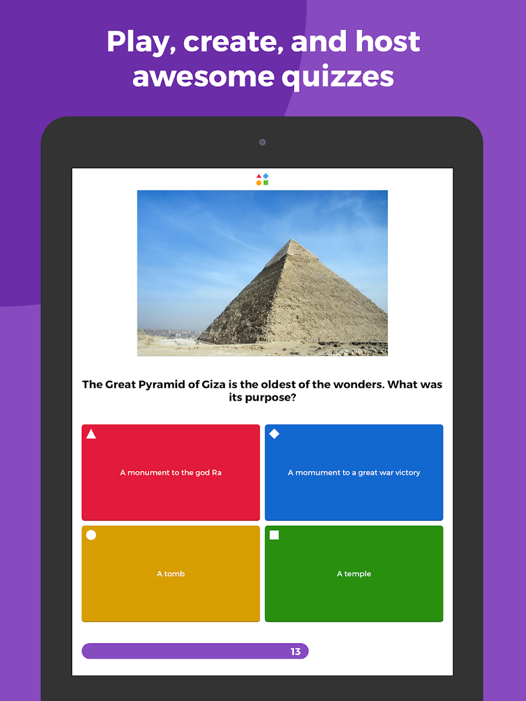

Warm-up - B

Slide 9
Are you familiar with Trend?
Warm-up - B
We can ask some silly questions.
What is our CEO’s name?
1. Eva Chang
2. Eva Chen
3. Eva Chan
4. Eva Cheng

Slide 10
RESEARCH
Pain Card
Pain Card
Pain Card
0. Facilitator helps distribute pain cards to each team member.
Pain Card
Pain Card
Pain Card
Pain Card
Pain Card
Pain Card
Leave the one you think is important. You can only have *2 cards at most.
Give out the rest of the cards to your right hand side.
N people = N rounds of the shifting process
When the shifting process finishes, everyone just discard the extra cards to remain at most two cards in your hand.
A
Pain Card
Discard
Pain Card
Pain Card
Pain Card
Pain Card
D
B
Pain Card
Pain Card
Pain Card
C
Pain Card
Pain Card
Pain Card
Pain Card
Pain Card
Pain Card
Pain Card
Pain Card

Slide 11
RESEARCH
Pain Card
Pain Card
0. Facilitator helps distribute pain cards to each team member.
Pain Card
Pain Card
A
Leave the one you think is important. You can only have *2 cards at most.
Give out the rest of the cards to your right hand side.
N people = N rounds of the shifting process.
Discard
Pain Card
Pain Card
Pain Card
Pain Card
Pain Card
D
B
Pain Card
Pain Card
Pain Card
C
Pain Card
Pain Card
Pain Card
Pain Card

Slide 12
RESEARCH
Pain Card
Pain Card
Pain Card
Pain Card
Pain Card
When the shifting process finishes, everyone just discard the extra cards to remain at most two cards in your hand.
“A” shares what pains he picked, and then B, C, D.
When sharing the pains, participant needs to finish the corresponding task (see next slide)
A
Discard
Pain Card
Pain Card
Pain Card
Pain Card
Pain Card
D
B
Pain Card
Pain Card
C
Pain Card
Pain Card
Pain Card
Pain Card
Notes:
10

Slide 13
RESEARCH
Pain Card
Pain Card
I want to enable more filters, but worried about the performance.
0. Each pain card will have a related task for them to finish.
Exhausting tuning process
Based on the card you pick, find the corresponding task card to finish the task.
After everyone finish the task, facilitator gives everyone a chance to add additional pains that are not in the card set, and describe their reasons or scenarios
At the end, each team needs to pick your top *3 pain points.
1
2
Task Card
Task Card
1
2
Answer the question:
How do you balance between the performance and security?
Draw your journey
Notes:
40

Slide 14
Top 3 Pain Points
Facilitator helps submit your top 3 pain points along with the result of task or scenarios.
Scenario Card
Scenario Card
Scenario Card
Task Result
Task Result
Task Result

Slide 15
How might things change when…
RESEARCH
The goal: Identify what needs may emerge in the future. Select the most likely and worth to fulfill needs in the future.
Situation Examples:
All of your infrastructure are in the cloud (ex: cloud-based IPS)
It is IoT era
You are building an intelligence-driven SOC
…
Future Card
Description
Front
Back
Rules:
Draw a situation card from the deck.
Everyone writes down what needs will emerge in the future.
Then, select top 3 emerging needs that most likely happen and valuable
Emerging Needs Card
Emerging Needs Card
Emerging Needs Card
Emerging Needs
Notes:
40

Slide 16
Only looking at existing problems is not enough, as an experienced consultant, you’ve noticed some trends and needs will be emerging in the future.
RESEARCH
Randomly draw a future card.
Discuss what needs will emerge and how will the future look like.
Select top 3 emerging needs that most likely happen and valuable to be fulfilled. Also needs to provide your reasons for choosing them.
Future Card
Future Card
Future Card
Future Card
Emerging Needs
Emerging Needs
Emerging Needs
Emerging Needs
Reasons
Reasons
Reasons

Slide 17
Break

Slide 18
Backstage preparation.
During the break time, facilitators consolidate those pains and needs and remove duplicated items.
PMs review the list of pains and needs, and prioritize each items based on the business value you foresee.
Priority represents the value of pains/needs. The mapping between priority and value will based on Fibonacci number (1, 1, 2, 3, 5, 8, 13…)
1.
2.
3.
4.
Priority | Value
1 | 8
2 | 5
3 | 3
4 | 2
5 | 1
5.
6.
7.

Slide 19
Product Planning
Research
Design
Sell

Slide 20
Making a product roadmap (Wish List)
1.
Priority One
Priority Two
Priority Three
2.
3.
4.
5.
Each team selects top 3 pains/needs from the list as their product roadmap. Put the most valuable and worth to solve problem as the priority one.
But at this stage, they don’t know the value of each item.
Later on, they will bid on those problems. They can only design the one they buy through the bidding.
6.
7.

Slide 21
Auction
1.
Each team will be given the same *amount of money to bid on the items
*The amount of money depends on how many items we have.
The host will start from first item (randomly select). If no team wants to bid on this item, then the host will proceed to next item.
2.
3.
4.
5.
6.
7.

Slide 22
Your roadmap will depend on what items you’ve win the bidding.
One
Two
Three

Slide 23
You present your product roadmap to CEO, but sometimes things are not as you expected… Your CEO apparently has a different roadmap in his mind.
Tasks:
Do the lottery from your product roadmap items.
Decide the problem they need to solve.
?

Slide 24
Product Planning
Research
Design
Sell

Slide 25
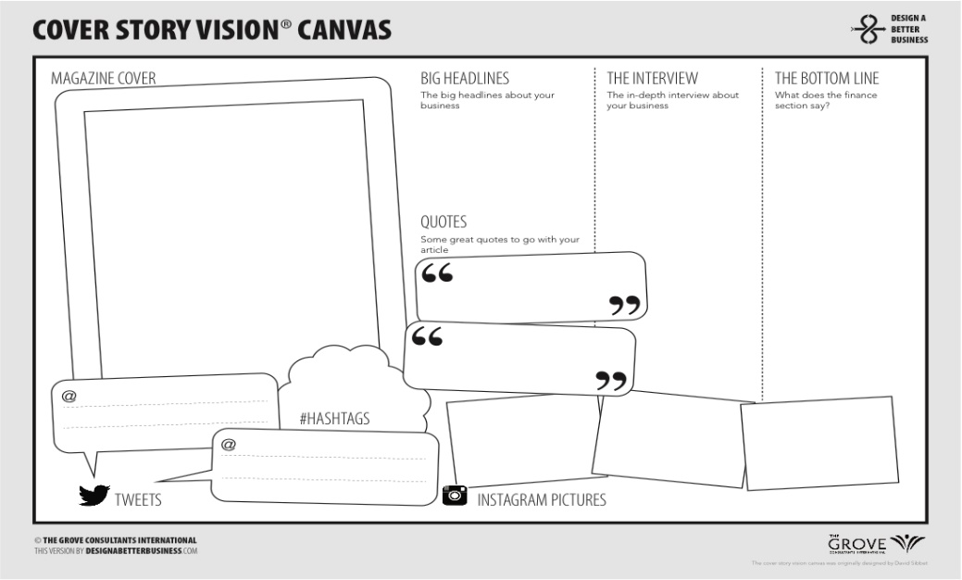
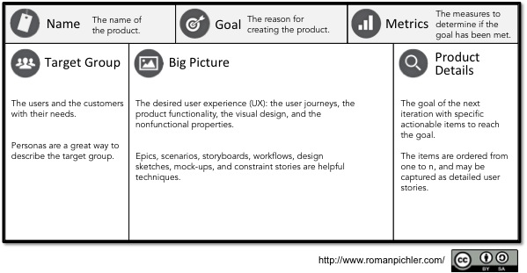
Brainstorm exercise
Run a brainstorm exercise to come out solutions and state your unique value proposition.
Just present a conceptual idea.
Deliverables:
Cover Story Vision Canvas
Product Canvas

Slide 26
Product Planning
Research
Design
Sell

Slide 27
Sell your ideas
IDEA 1
IDEA 2
IDEA N
Each team has 7 minutes to introduce their ideas.
Everyone (include Trenders and guests) has N chips for the idea you want to invest.
Leave your comments for each idea anonymously.
The final score = received investment + the value of the problem.

Slide 28
Award Time!
TBD

